Slide 1
DLA Distribution Business Opportunities
Forecast
Karen Ghani, Chief of the Contracting Office, Distribution J7
March 31, 2024

Slide 2
Agenda
DLA Distribution J7 Information
Location Acronyms
How We Approach Business
Spend Profile – Services
Procurement Forecast – Services
Spend Profile – Supplies
Procurement Forecast – Supplies
Industry Engagement Plan

Slide 3
DLA Distribution J7 Information
Solicitations and Requests for Information are advertised at SAM.gov
  Search for DLA Distribution under DODAAC SP3300
  Contact information will be available within each Solicitation/Request for Information
  Vendors can setup searches and turn on notifications (See GSAFSD_kb_articles - GSA Federal Service Desk Service Portal)
Oral quotes may be used for items under $25k
APEX Accelerators (previously PTACs) offer free education and training to help small businesses participate in DoD contracts or contracts with other agencies. You can identify your local APEX Accelerator at:
  https://www.aptac-us.org/contracting-assistance/
Please contact us at DistributionJ7@dla.mil if you have any questions

Slide 4
DLA Distribution Location Acronyms
DDAA – Anniston, AL
DDAG – Albany, GA
DDBC – Barstow, CA
DDCN – Cherry Point, NC
DDCT – Corpus Christi, TX
DDDA – Djibouti, Africa
DDDC – San Diego, CA
DDDE – Europe
DDDK – Korea
DDGM – Guam
DDHU – Hill, UT
DDJC – San Joaquin, CA
DDJF – Jacksonville, FL
DDNB – Bahrain
DDNV – Norfolk, VA
DDOO – Oklahoma City, OK
DDPH – Pearl Harbor, HI
DDPW – Puget Sound, WA
DDRT – Red River, TX
DDSI – Sigonella, Italy
DDSP – Susquehanna, PA
DDTP – Tobyhanna, PA
DDWG – Warner Robins, GA
DDYJ – Yokosuka, Japan

Slide 5
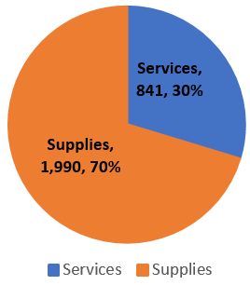
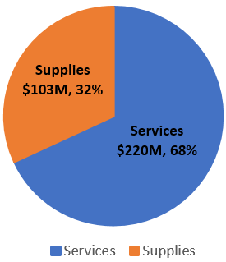
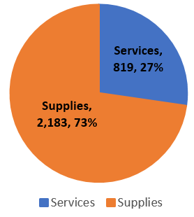
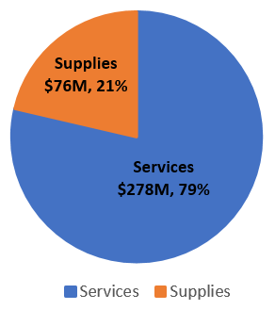
How We Approach Business
DLA Distribution Procurement Profile
FY 22 Actions, 2,831
FY 22 Obligations, $323M
FY 23 Actions, 3,002
FY 23 Obligations, $354M
5
Notes:
Used net obs and no Fedmall because we believe that is what industry would be most interested in when considering doing business with AB2-7

Slide 6
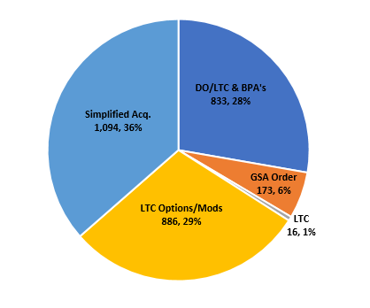
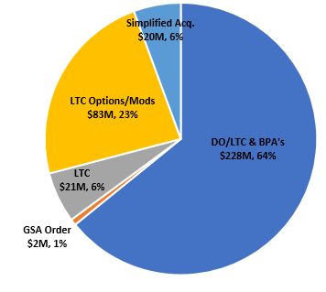
How We Approach Business
How We Buy
Actions – 3,002
Amount - $354M
FY23
Source: SAM.gov
6
Notes:
Used net obs and no Fedmall because we believe that is what industry would be most interested in when considering doing business with AB2-7

Slide 7
How We Approach Business Small Business
Category | FY22 Goals | FY22 Achievements | FY 23 Goals | FY23 Achievements | FY24 Goals
SB | 60% | 73.43% | 60% | 73.31% | 58%
SDB | 30% | 49.50% | 25% | 50.66% | 25%
WOSB | 5% | 22.57% | 5% | 18.72.% | 5%
SDVOSB | 3% | 8.25% | 3% | 15.49.% | 5%
HUBZn | 3% | 4.06% | 3% | 2.94% | 3%
YTD 2/29/2024

Slide 8
How We Approach Business
FY23 Competition Data
Goal 88%*
FY 23 Overall Achievement**
88% $311,254,450.92 Competed
12% $44,170,899.10 Not Competed
100% $355,425,350.02
*Pending Approval
**FY22 Overall Achievement 90.61%
Source: SAM.gov
As of September 30, 2023

Slide 9
How We Approach Business Market Research
Searches
  Internet - search engine
  GSA
  Small Business Dynamic Search (NAICS search)
  Small Business tracking spreadsheet
    Locally maintained
    Contact DLA.Distribution.OSBD@dla.mil
  History – within Distribution procurement tool/FPDS
Sources Sought Postings (SAM.gov)
Past Performance (Informal Offeror List)
Market Intelligence Tools
  FactSet
  ThomasNet
Capabilities Info/Line Cards sent to DistributionJ7@dla.mil will be
provided to appropriate Contracting Officers
9

Slide 10
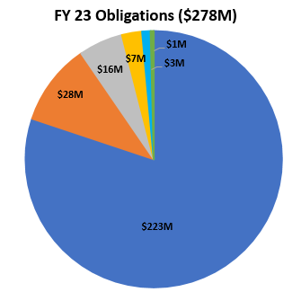
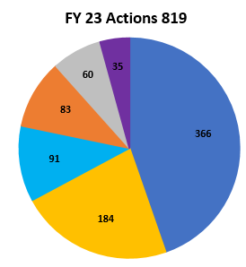
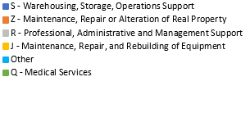
DLA Distribution
Spend Profile - Services
Distribution Operations
  11 GOCOs
  S&D of MRE, FF&V
  Labor Augmentation
  3PL Haz Material Support
Global Distribution Expeditionary Contract
Professional Services
Facilities
  Janitorial
  Equipment Maintenance & Repair
  Facilities Maintenance & Repair
Minor Construction

Slide 11
Procurement Forecast - Services
Storage & Distribution, Warehousing, MHE Maint., Janitorial
Long Term Contracts/IDIQ
FY25 (Re)Solicitations
GOCO/COCO: DDDC
Retail Support: DDAG
Janitorial Services: DDWG
Global Distribution Expeditionary Contract
CMS and 3PL – Warner Robins Air Force Base
VLM Maintenance: DDAG, DDNV, DDYJ, DDDC
FY26 (Re)Solicitations
GOCO/COCO: DDBC
Janitorial Services: DDRT
East Coast Export (Fresh Fruit and Vegetable Cross Dock)

Slide 12
Procurement Forecast - Services
Maintenance, Repair or Alteration of Real Property (Facility Repair, Minor Construction)
Long Term Contracts/IDIQ
FY25 (Re)Solicitations
N/A
FY26 (Re)Solicitations
Multiple Award Task Order Contract (MATOC) for Construction (DDSP Paving)

Slide 13
Procurement Forecast - Services
Professional, Administrative, and Management Support
Long Term Contracts/IDIQ
FY25 (Re)Solicitations
Logistics Modernization Integration Support – Pool 2
Professional Support Services (J3)
Professional Support Services (WMS)
American Sign Language Interpreting
FY26 (Re)Solicitations
N/A

Slide 14
Procurement Forecast - Services
Maintenance, Repair and Rebuilding of Equipment (Maint. Equipment)
Long Term Contracts
FY25 (Re)Solicitations
N/A
FY26 (Re)Solicitations
N/A

Slide 15
Procurement Forecast - Services
Maintenance, Repair and Rebuilding of Equipment (Maint. Equipment)
Simplified Acquisitions
FY25 (Re)Solicitations
Crane Maintenance: DDAG
Lenel Maintenance: DDCT, DDHU, DDJF, DDOO
Trailer Maintenance: DDPW
Fire Department Equipment Maintenance: DDSP
Crane Repair Services: DDSP
Lektriever ASRS Maintenance: DDSP
UPS Maintenance: DDWG
Preventative Maintenance/Remedial Maintenance – Scales: DDSP, DDCT
Weight Handling Equipment – Maintenance: DDWG
Grounds Maintenance: DDWG
F-35 Commercial Line: DDOO
Container Rental: DDNV
Quarterly Carpet Cleaning: DDBC
Dock Levelers Maintenance: DDAG
Portable Toilet Rental: DDAG

Slide 16
Procurement Forecast - Services
Maintenance, Repair and Rebuilding of Equipment (Maint. Equipment)
Simplified Acquisitions
FY26 (Re)Solicitations
Ice Machine Maintenance: DDWG
Portable Toilet Rental: DDRT
Laundry Services – Towels: DDJC
Industrial Cleaning: DDHU
BryAir Dehumidifier Maintenance: DDAG

Slide 17
Procurement Forecast - Services
Long Term Enterprise Service Contracts
Effort | FY Expiration
GOCO/COCO: DDHU | FY 2027
Professional Services Support (BD) | FY 2027
Fire System Maintenance: DDSP | FY 2027
Installation Support Services: DDJC | FY 2027

Slide 18
Procurement Forecast - Services
Simplified Acquisitions
Effort | FY Expiration
Postage Meter Maintenance: DDNV | FY 2027
Floor Dust & Mop Service: DDPW | FY 2027
Ice Machine Maintenance: DDAA | FY 2028

Slide 19
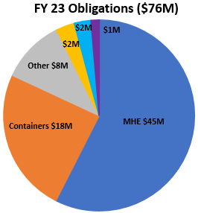
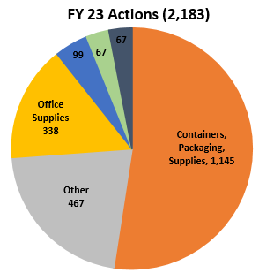


DLA Distribution
Spend Profile - Supplies
Operational
  Boxes & Envelopes
  Packaging Material (bubble wrap, sealed air)
  Pallets
COVID Related & Cold Chain
Automated Material Handling Equipment
Modernization/Communications (i.e. Voicepick)
Office Supplies (i.e. Tape, labels)
Facilities (i.e. Racking)

Slide 20
Procurement Forecast - Supplies
Categories of supply requirements are based upon Distribution Center needs/budget
  Material Handling Equipment
  Racking, Cabinets, Bins, Shelving, Furniture
  Containers, Packaging, and Packing Supplies (Boxes)
  Communication Equipment
  Office Supplies and Devices
Supply requirements traditionally increase during FY 4th Quarter
Monitor Contract Opportunities at SAM.gov under DODAAC SP3300

Slide 21
Procurement Forecast - Supplies
Containers, Packaging, and Packaging Supplies
Long Term Contracts/IDIQ
FY25 (Re)Solicitations
Corrugated Fiberboard
Gel Packs/Cold Storage
Packaging Materials & Envelopes
Plastic Bags & Heat-Sealed Bags
Plastic Film & Sheets
Cleaning & Polishing Compounds
Misc Materials Handling Equipment
Tires
Firefighter Personal Protective Equipment
Safety Shoe Footwear
FY26 (Re)Solicitations
Sheet Metal
Nails and Screws
Insulated Thermal Shipping Containers
Wooden Shipping Containers - DDOO
Sandpaper
Batteries & Chargers
SPI Containers

Slide 22
Procurement Forecast - Supplies
Office Supplies and Devices
Long Term Contracts/IDIQ
FY25 (Re)Solicitations
Voice Pick Labels
FY26 (Re)Solicitations
Toner

Slide 23
Procurement Forecast - Supplies
Long Term Enterprise Supply Contracts
Effort | FY Expiration
Special Purpose Clothing | FY 2027
Nails and Screws | FY 2027

Slide 24

DLA Distribution J7
Industry Engagement Plan
DLA Director’s Intent
Warfighter Always is our #1 priority
DLA’s Strategic Plan meets the evolving requirements of the Warfighter and the Nation with a target transformative approach encompassing the most critical priorities for the next five years
To reflect current conditions, DLA introduced a refreshed Industry Engagement Plan to supplement the DLA Strategic Plan 2021-2026
DLA Distribution J7’s IE Plan builds off of
DLA HQ’s IE 5 Focus Areas
Supplier Communication and Interaction
Balancing Business Decisions and Fiduciary Responsibilities
Supplier Feedback Management and Advocacy
Drive Efficiencies and Innovation in Our Business
Assess and Mitigate Supply Chain Risk
Metrics to performing against this plan include:
Manage acquisition performance
Meet SB (60%) and Competition (88%) Goals
Increased AbilityOne engagement
Refreshed DLA Distribution IEP
Participate in DLA HQs Association Webinar – Demand Forecast
Increased presence at Industry Engagement events
Planning for next DLA Distribution Industry Day to be tentatively held Spring/Summer 2025

